Slide 1
Cloud Technology & Databases
BugSmashers
3/7 Hack Night!

Slide 2
Imagine you’re the CEO of a manufacturing company
1
You have three different locations across the United States, one for HR, one for Research, one for Manufacturing.
1
2
2
Your HR team needs collaboration from the heads of each department on an important document, but it’s updated often…
3
They get tired of emailing the document back and forth, losing progress, and manually updating changed sections.
3
4
4
They need a solution for this problem, they need to edit the document at the same time, but there is no technology to do so.
Notes:
d3

Slide 3
Gradient Clouds Infographics
Now you’re left with a couple of options:
Hire a team of programmers to develop, and maintain a system for you to work on documents.
Find someone to sell you access to a system like that for a cheap price and use that to work on documents.
Notes:
d3

Slide 4
This is why we use the cloud!
Affordability
You pay for what you use, much cheaper than doing it yourself!
Availability
Cloud is always available and easy for everyone to use/implement
Data Management
Cloud databases’ advantages for data storage and risk
Scalability
You can always use or pay for more data.
Software
Deploying, testing, and building applications.
Notes:
dk8

Slide 5
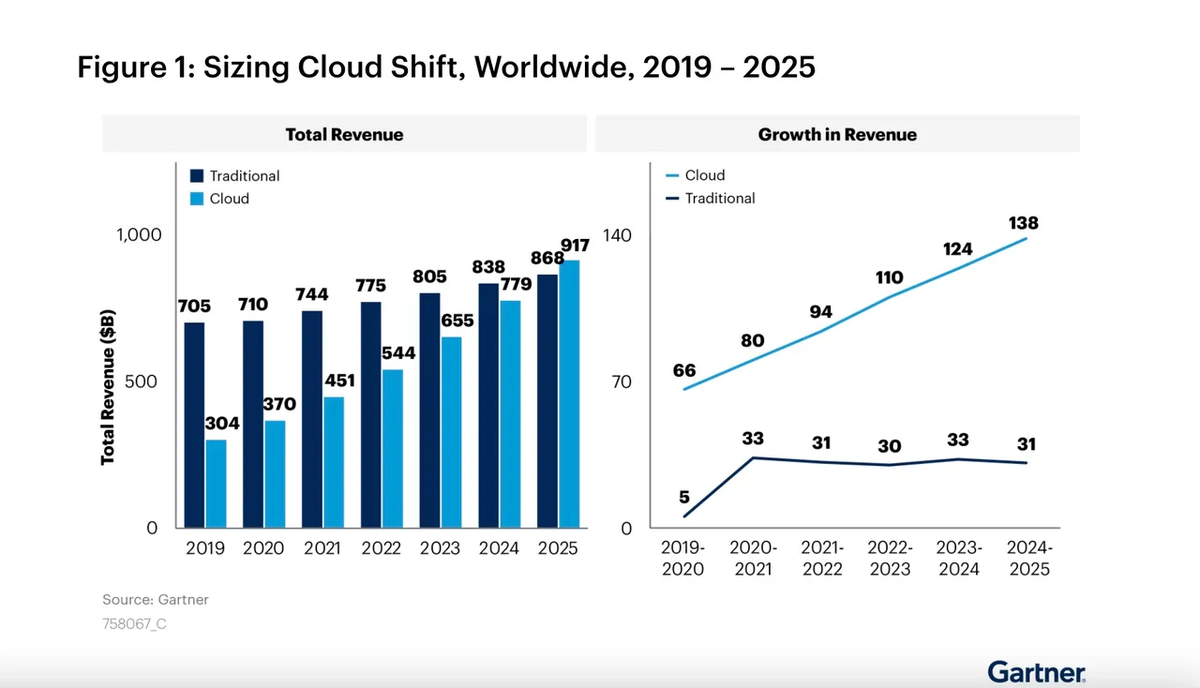
Why we use the cloud

Slide 6
Cloud Business Models
SaaS Software as a Service Netflix, Hulu, Adobe, Microsoft 365
IaaS Infrastructure as a Service Google Compute Engine, Azure
PaaS Platform as a Service Azure, Heroku, Google App Engine
Notes:
d3
https://en.wikipedia.org/wiki/Software_as_a_service

Slide 7
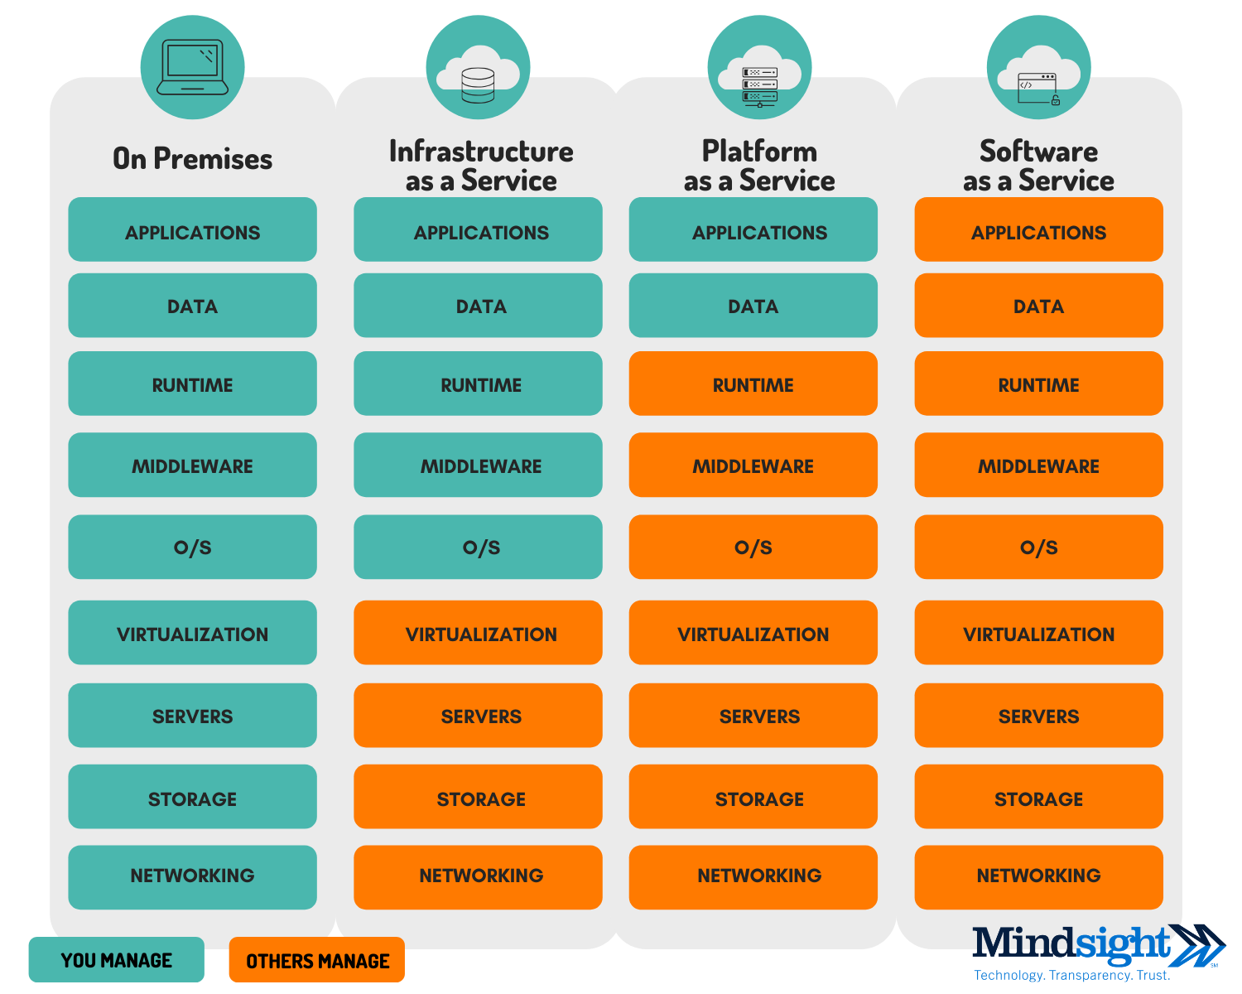
Cloud Business Models
Notes:
https://en.wikipedia.org/wiki/Software_as_a_service

Slide 8
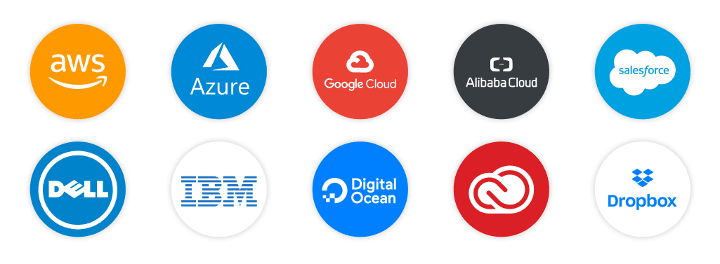
Examples of Cloud Infrastructure Providers
Notes:
dk8

Slide 9
How do databases work into cloud infrastructure?
AWS
Amazon RDS
DynamoDB
Azure
SQL Database
CosmosDB
Google Cloud
Cloud SQL
Cloud Firestore
Bigtable
Notes:
dk8

Slide 10
How the cloud works
Servers
Servers are the endpoints we use to connect to cloud applications.
VMs
The Cloud
VMs support these applications by performing different services on these servers.
Networking
Connecting to, and communicating information becomes complex when machines have machines…
Notes:
d3
Servers - servers store off-site data and off-site applications. they provide the hardware for the functionality that we use the cloud for.
VMs - VMs support the applications that a cloud service provider has. They provide more functionality for a server, by providing different OSes or specialized machines for performing specific tasks.
VMs with the same functionality can also work together in things called “clusters” A cluster is a collection of virtual machines working to perform a specific task
Networking - Networking is an important aspect of the cloud, as computers need to communicate with eachother, and with the cloud. This problem becomes increasingly complex when considering Virtual Machines. Cloud networking is incredibly important in the cloud providing the services it does.

Slide 11
You can use the cloud in your projects!
Redis & Databases!
Python Notebooks!
Web Servers!
Cloud Computing
Dev Stack!
Cloud Networking
Notes:
Python Notebooks - Great example of cloud computing! offloads heavy computing from your computer to the cloud!
Redis databases - cloud database accessible from anywhere
Web Servers - Create and deploy web servers without worrying about setting up hardware, many tutorials to build a cloud webserver online
Dev Stack - create applications with a front and back end using cloud databases, webservers, etc. without running anything on your computer
Cloud networking -so much communication and rerouting has to happen for devices to work in the cloud, working with a cloud network where all devices are connected to a cloud is becoming more common and is interesting to try to understand

Slide 12
Cloud Compute Learning Resources
AWS Educate
Free, self-paced training courses using AWS services
Cloud Practitioner Essentials
Course to gain the AWS Cloud Practitioner certification
Microsoft Learn
Free training course with an emphasis on path selection
Google Cloud Training
Free (30-day trial) training setup with path determined by desired role
Cloud Architect, Developer, Network Engineer, etc.
Notes:
d3

Slide 13
Using The Cloud - Examples!
Code with us!
Machine Learning
Databases
Notes:
ML - show python code from last week and talk ab where the cloud is used - dk8
Databases - simple redis database with querying and stuff - d3

Slide 14
Free Cloud Hosting for Students!
AWS Educate: Amazon Web Services (AWS) offers the AWS Educate program, which provides students access to AWS cloud resources for learning. It includes a range of services and is a great way to get hands-on experience with cloud computing.
Microsoft Azure for Students: Microsoft Azure provides free Azure credits to eligible students through its Azure for Students program. It allows students to use various Azure services and resources for learning and building applications.
Google Cloud Platform (GCP) Education: Google Cloud offers free GCP credits and access to their cloud platform for students through their Google Cloud Platform Education program. This program is designed to help students learn about GCP services.
Notes:
dk8

